Slide 1
AIML PROJECT
Team Members: Gurseerat (2210991599)
Mannat(2210990556)
Harshita(2210991643)
Nihar(2210990607)
Project Name: Wine quality prediction
Faculty Coordinator: Dr. Monica Dutta
:
Chitkara University Institute of Engineering and Technology, Punjab

Slide 2
Table of Contents
Introduction
Objective
Problem Statement
Methodology
Algorithm
Result
Project Highlights
References/Links used

Slide 3
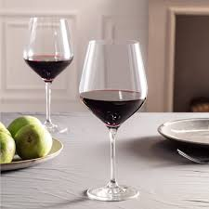
Introduction
Wine quality prediction is a powerful tool that is used to decipher the intricate patterns that define wine quality, leveraging the power of data science and machine learning.
we have crafted a predictive model that aims to unveil the potential excellence of a wine even before it graces the palate.

Slide 4
Objective
Develop a predictive model to forecast the quality of wines based on various input parameters.
Utilize machine learning algorithms to analyze historical data on wine characteristics and quality ratings.
Identify key features such as grape variety, weather conditions, chemical composition, and sensory attributes that influence wine quality.
Provide winemakers with actionable insights to optimize production processes and improve the overall quality of their wines.
Empower consumers to make informed purchasing decisions by offering transparent and reliable assessments of wine quality.

Slide 5
Problem Statement
In industries, understanding the demands of wine safety testing can be a complex task for the laboratory with numerous analytes and residues to monitor.
our application's prediction will provide ideal solutions for the analysis of wine, which will make this whole process efficient and cheaper with less human interaction.

Slide 6
Methodology
Data Collection: Gather a comprehensive dataset including information on various parameters such as grape variety, weather conditions, chemical composition, and sensory attributes.
Data Preprocessing: Cleanse the dataset to remove inconsistencies, missing values, and outliers that could distort the analysis. Normalize or standardize numerical features to ensure they are on a consistent scale.
Feature Selection: Identify the most relevant features that significantly impact wine quality through exploratory data analysis and statistical tests.

Slide 7
Training and testing
Training Data: Used to train the model by adjusting its parameters to minimize prediction errors.
Testing Data: Used to evaluate the trained model's performance on unseen data, providing an estimate of its generalization ability.
Model Training: Train the chosen model on the training data using the validation set to optimize model performance.

Slide 8
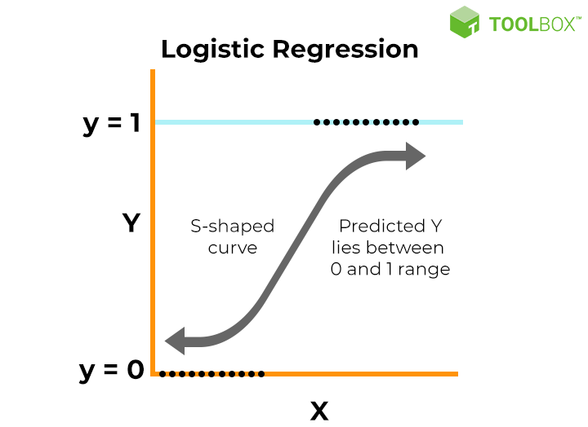
Algorithms
Logistic regression is a statistical method used for binary classification tasks, where the goal is to predict the probability that an instance belongs to a particular class.
We used logistic regression for the prediction of wine quality. In logistic regression we have used solver=‘newton-cg’ parameter which is used for the optimization of the large dataset.
Here, class weights parameter is used due to the imbalance in the dataset.

Slide 9

Support Vector Machine (SVM) is a powerful supervised machine learning algorithm used for classification and regression tasks. However, it's primarily known for its effectiveness in classification
Svm has high variance which leads to overfitting, to tackle overfitting we have used class weights parameter to boost accuracy by 6%.

Slide 10
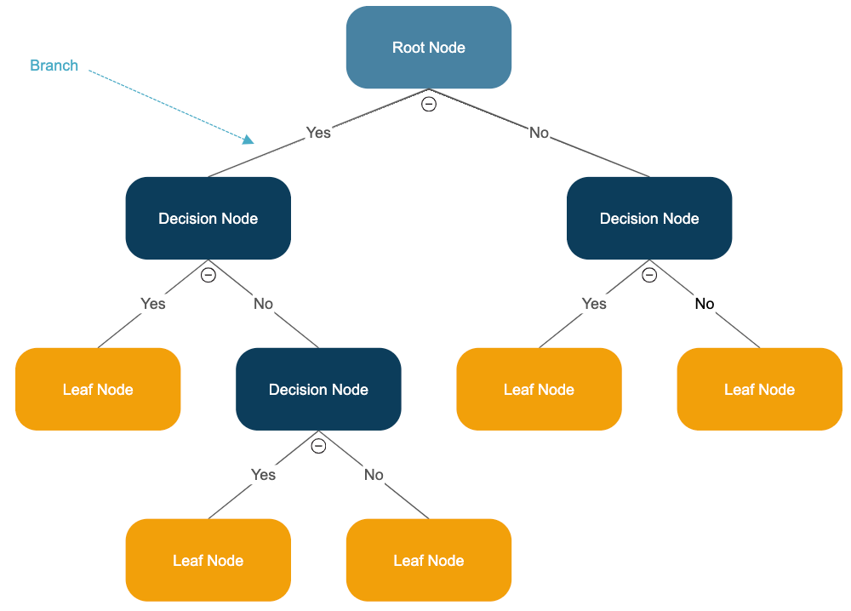
Decision trees are a popular supervised learning algorithm used for both classification and regression tasks in machine learning. They are a type of model that predicts the value of a target variable by learning simple decision rules inferred from the input features.
Here we have used ‘random state=100’ parameter, it is used to control the random number generator used to shuffle the data.
We’ve used class_weight={'Bad': 0.67, 'Good': 0.87}, which further increases our accuracy by 1 percent
approximately.

Slide 11
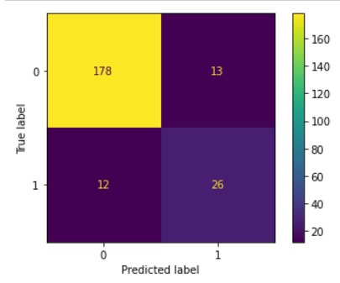
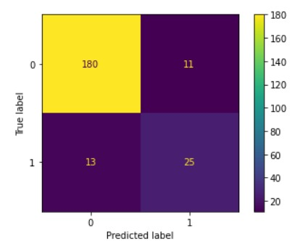
Results
Logistic regression svm

Slide 12
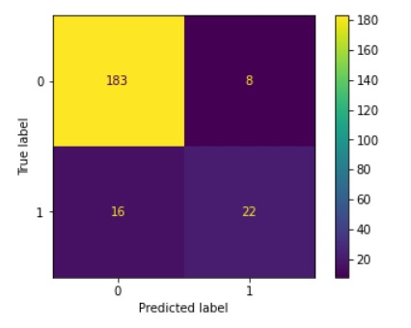
Decision Trees

Slide 13

Project Highlights
Quality is moderately correlated to alcohol (0.48).
There is high correlation between following variables:
Citric Acid and fixed acidity (0.67)
Density and fixed acidity (0.68)
Total Sulphur dioxide and free Sulphur dioxide (0.66)
Accuracy of logistic regression model(including parameters).

Slide 14
Reference
https://www.kaggle.com/code/nimapourmoradi/red-wine-quality

Slide 15


